Slide 1




TRANSPORT OF CONTAMINANTS BY ATMOSPHERIC DUST AND AEROSOL
Paola L. Colmenares
Chemical Engineering
University of Arizona
Research supported by:
NIEHS Superfund Research Program
NASA Space Grant Consortium 2015
April 2016 Arizona Space Grant Symposium
University of Arizona, Tucson, AZ
Notes:
T = 10 s

Slide 2
Objective
2
To develop and validate a model to forecast the transport and deposition of windblown contaminated dust from mine tailing impoundments
Notes:
T=30 s

Slide 3
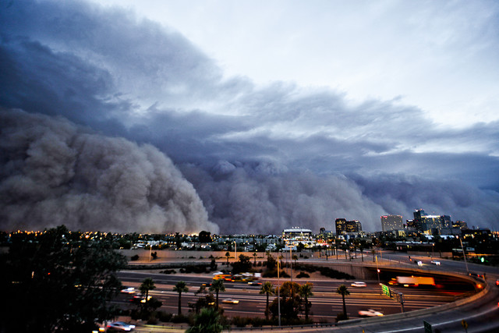
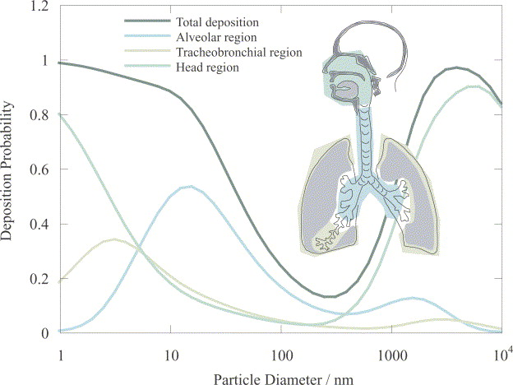
Background
3
Impact of Mining Operations on the Atmosphere
Source J. Csavina et al. 2012
Notes:
T = 1 min
Importance of study
Result of mining operations
Aeolian transport poses risks to the environment and health

Slide 4
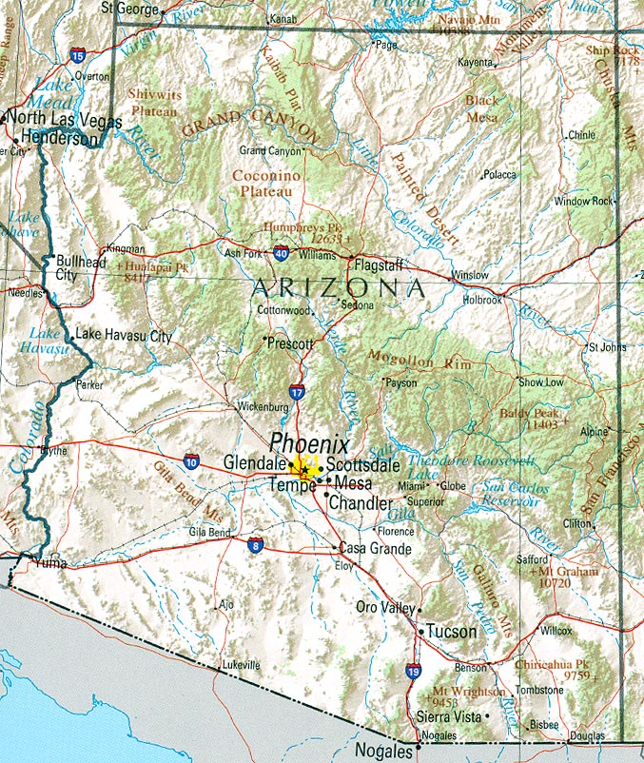
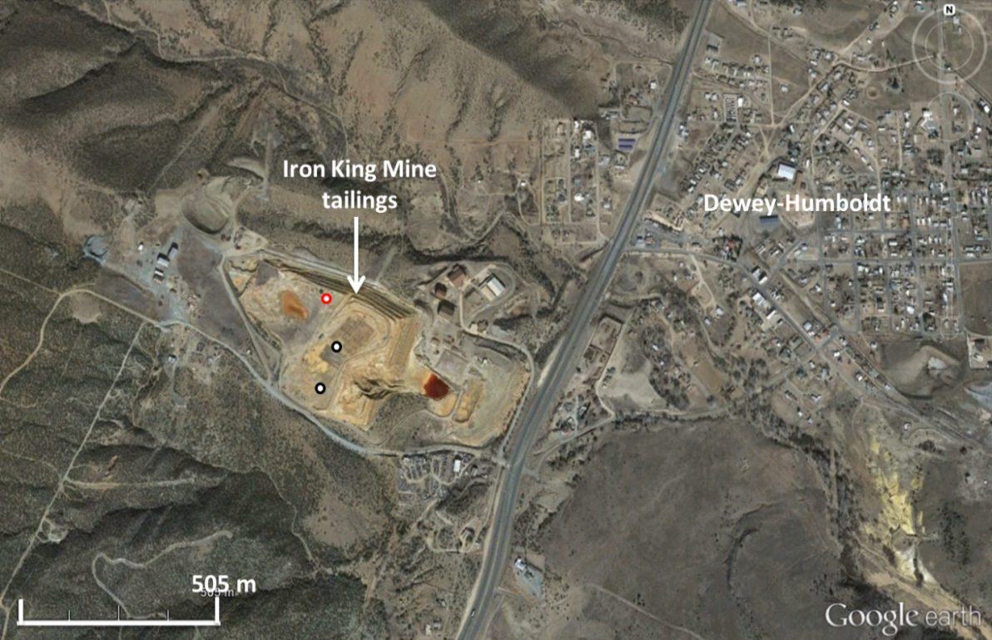
Field Site
4
Iron King Mine
Directly adjacent to the town of Dewey-Humboldt
Superfund site since 2008
220,000 m² tailings were impounded on property
Tailings heavily contaminated with lead and arsenic
Notes:
T = 1min

Slide 5
Computational Fluid Dynamics
5
Apply a Computational Fluid Dynamics (CFD) software tool, ANSYS FLUENT
A strategy to model wind and particle flows from areas susceptible to wind erosion
Able to treat topographical details such as terrain variation as well as local aerodynamics and turbulence
Notes:
T = 1 min

Slide 6
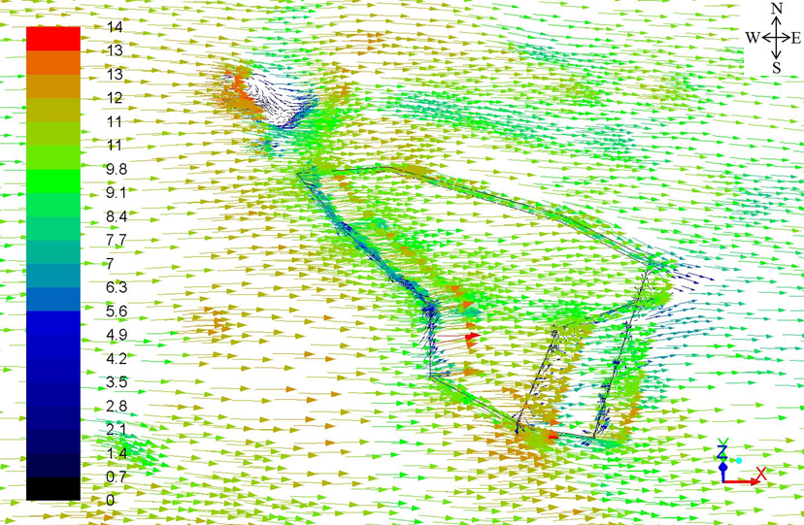
CFD Wind Velocity Simulations
6
Wind velocity magnitude
Wind Speed (m/s)
FLUENT (ANSYS corp)
Wind velocity vectors adjacent to the tailings and ground boundaries for an eastward simulated wind direction initialized with a 7m/s velocity at a 10-m height logarithmic wind profile
Notes:
T = 1 min
At the centroid of the elements directly adjacent to the tailings and ground boundaries

Slide 7
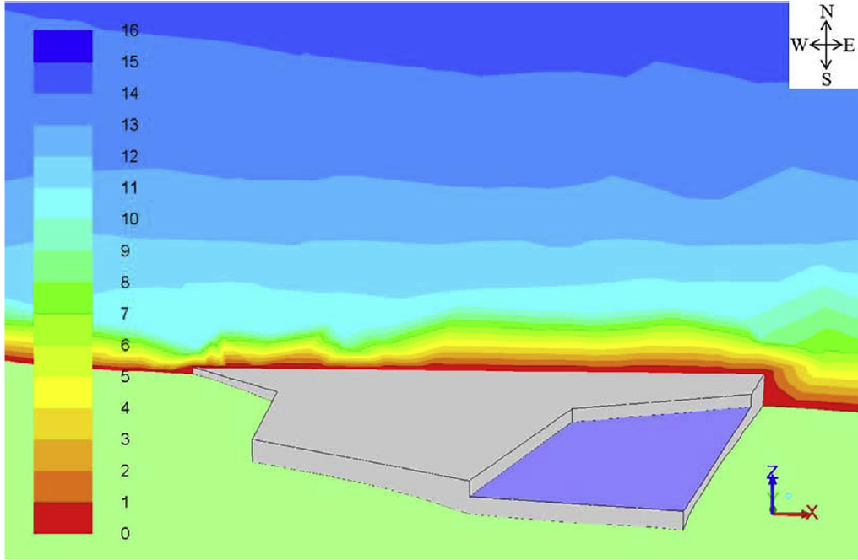

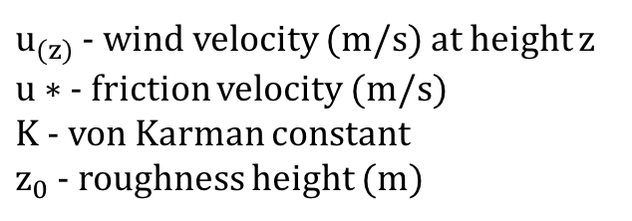
CFD Wind Velocity Simulations
7
Wind speed magnitude contours
Velocity initialization
$$u_{(z)}=\frac{u∗}{K}ln\frac{z}{z_{0}}$$
$u_{(z)}$ - wind velocity (m/s) at height z
$u∗$ - friction velocity (m/s)
$K$ - von Karman constant
$z_{0}$ - roughness height (m)
Wind Speed (m/s)
Turbulent flow field parameterization
k-epsilon turbulent kinetic model
Fluid flow boundary conditions
FLUENT (ANSYS corp)
Wind speed contours along an eastward oriented vertical plane for an eastward simulated wind direction for winds initialized with a 7 m/s at a 10 m height logarithmic wind profile
Notes:
T=1 min

Slide 8
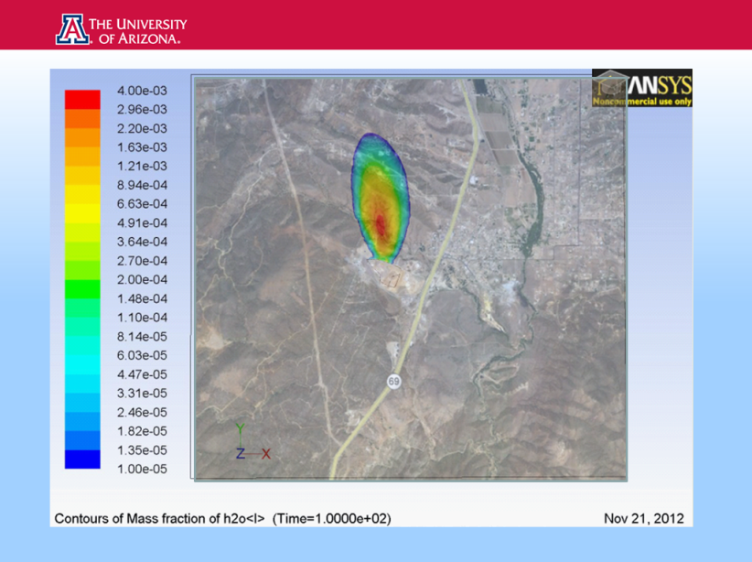
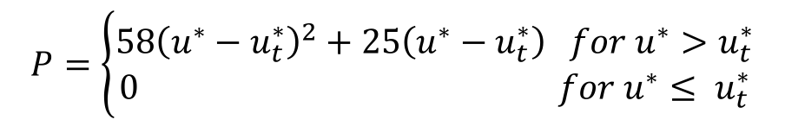
CFD Plume Simulations
8
Gaseous plume simulations
Tailings source
EPA AP42 wind erosion model
Mass fraction
$$P=\left\{\begin{aligned}58{\left(u^{∗}−u_{t}^{∗}\right)}^{2}+25\left(u^{∗}−u_{t}^{∗}\right) for u^{∗}>u_{t}^{∗} \\ 0 for u^{∗}≤ u_{t}^{∗}\end{aligned}\right.$$
FLUENT (ANSYS corp)
Mass fraction contours calculated for the centroid value of elements directly adjacent to the ground boundary of a northward species plume simulation 90 s after emission from the tailings
Notes:
Calculated for the centroid value of elements directly adjacent to the ground boundary

Slide 9
Future Work
9
Application of model to other mine locations and dust storms
Coupling transport model to the Weather Research Forecasting (WRF) model to predict contamination events
Notes:
T = 30 s

Slide 10
Acknowledgements
10
Many thanks to:
NASA Space Grant Consortium
NIEHS Superfund Program
Dr. Eric Betterton and Dr. Eduardo Saéz
Susan Brew and Chandra Holifield
Kyle Rine, Tianqi Zhang, Michael Stovern, Mary Jones, Victoria Raught, Tania Rodriguez, and Hongyi Cai

Slide 11
Thank You!
Notes:
Possible Questions:
Weather Research Forecasting Model/ Next Steps
CFD vs empirical methods
Simulations – Length of simulations if to be applied to WRF,
Studies conducted showing environment/ health effects
Superfund site
ANSYS F

